Slide 1
WARMLY WELCOME ALL TEACHERS TO OUR CLASS
ENGLISH GRADE 3
Unit 10: Break time activities
Lesson 2 - Part 1, 2, 3
Teacher: Cao Thi Giang

Slide 2
WARM UP

Slide 3
Unit 10: Break time activities
Lesson 2 - Part 1, 2, 3

Slide 4
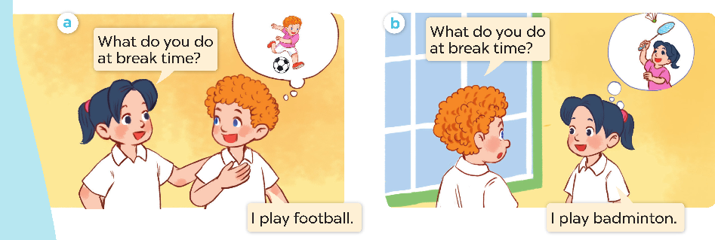
1. Look, listen and repeat

Slide 5
Vocabulary
2. Listen, point and say

Slide 6
Lip reading Game

Slide 7
Model sentence
2. Listen, point and say

Slide 9
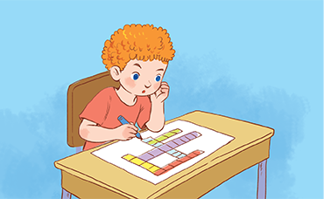
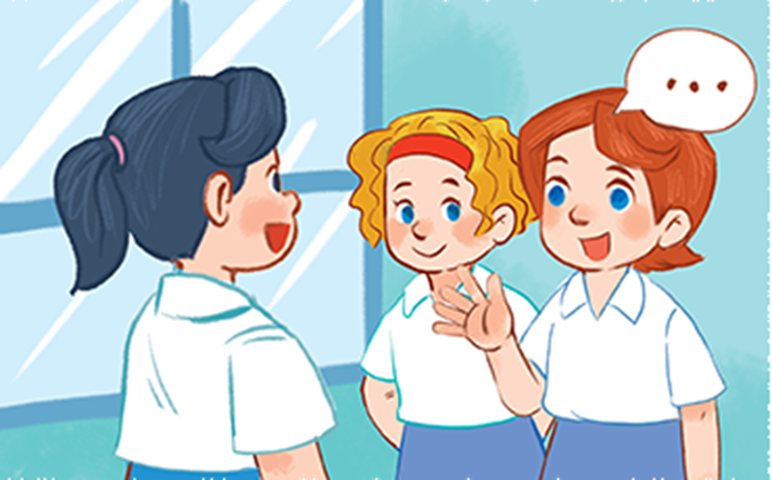
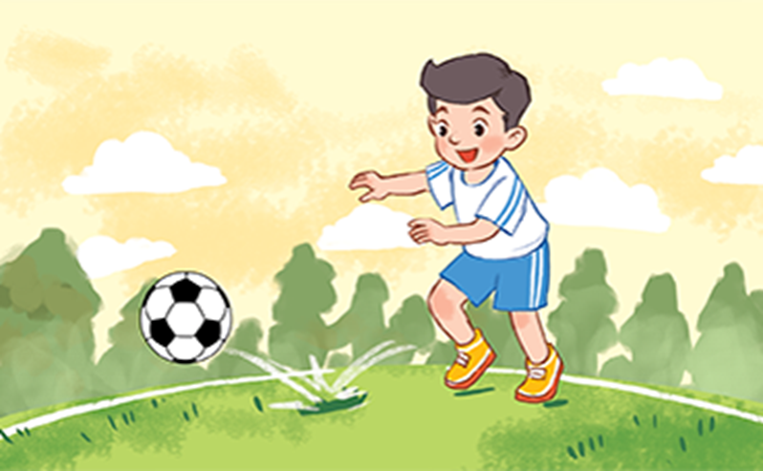
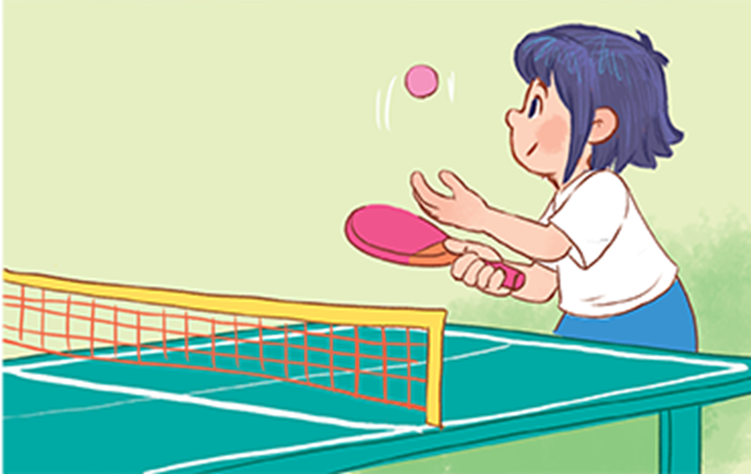
2. Listen, point and say
a
b
What do you do at break time?
do word puzzles
chat with my friends
I
c
d
play football
play table tennis

Slide 10
2. Listen, point and say
a
do word puzzles

Slide 11
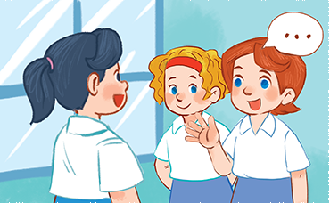
2. Listen, point and say
b
chat with my friends

Slide 12
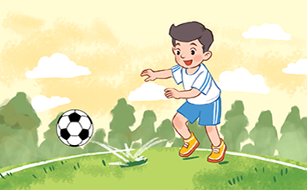
2. Listen, point and say
c
play football

Slide 13
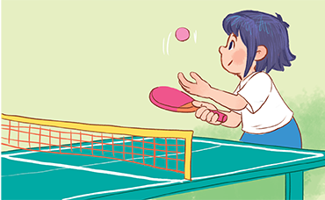
2. Listen, point and say
d
play table tennis

Slide 14
2. Listen, point and say
a
do word puzzles

Slide 15
2. Listen, point and say
b
chat with my friends

Slide 16
2. Listen, point and say
c
play football

Slide 17
2. Listen, point and say
d
play table tennis

Slide 18
2. Listen, point and say
a
do word puzzles

Slide 19
2. Listen, point and say
b
chat with my friends

Slide 20
2. Listen, point and say
c
play football

Slide 21
2. Listen, point and say
d
play table tennis

Slide 22
2. Listen, point and say
a
b
What do you do at break time?
do word puzzles
chat with my friends
I
c
d
play football
play table tennis

Slide 23
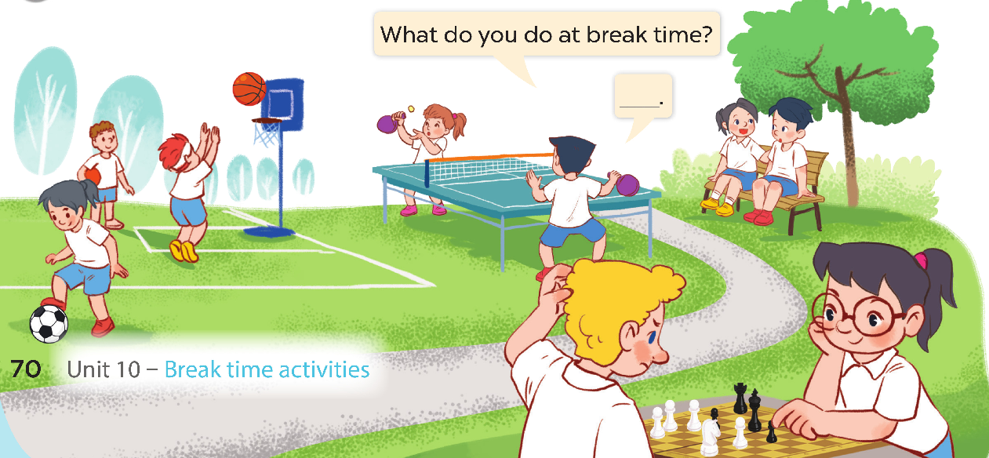
3. Let’s talk

Slide 24
Bingo Game

