Slide 1
My hobbies
LESSON 3.2

Slide 2
TABLE OF CONTENTS
Warm up
Review
Review
Activities

Slide 3
WARM UP
WARM UP

Slide 4
Contents of this template

Slide 5
WARM UP
REVIEW

Slide 6
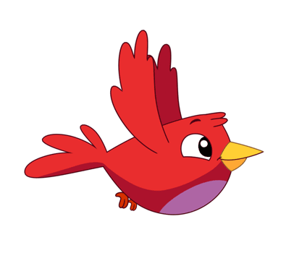
Nest Building
Competition

Slide 8
Look and choose
a. RUNNING
b. WALKING
c. PAINTING
d. COOKING

Slide 9
Listen and choose
a.
b.
c.
d.

Slide 10
What is your hobby?
I like……………………..
a. SWIMMING
b. PAINTING
c. RUNNING
d. SINGING

Slide 11
What is your hobby ?
a.
b.
c.
d.

Slide 12
W-D-A-R-G-I-N
a. DRWAING
b. DARWING
d. INGDRAW
c. DRAWING

Slide 13
I like painting.
a.
b.
c.
d.

Slide 14
like/ dancing./ I
a. I dancing like.
b. I like dacning.
c. I like dancing.
d. like I dancing.

Slide 15
It's cooking.
a. What's your name?
b. What's your hobby?
c. Do you like cooking?
d. How are you?

Slide 16
What is your hobby?
I …………dancing.
a. like
b. likes
c. have
d. am

Slide 17
Choose odd one out
a. cooking
b. swimming
c. walking
d. eye

Slide 19
WARM UP
Reading

Slide 20
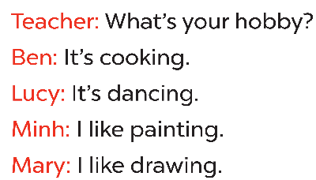

Slide 21
WARM UP
Writing

Slide 22
Hello! My name is
<
I like
>
I like
What’s your hobby?

Slide 23
1. What’s / hobby / your ?
What’s your hobby?
2. cooking / It’s.
It’s cooking.
3. singing / like / I.
I like singing.

Slide 24



